Slide 1
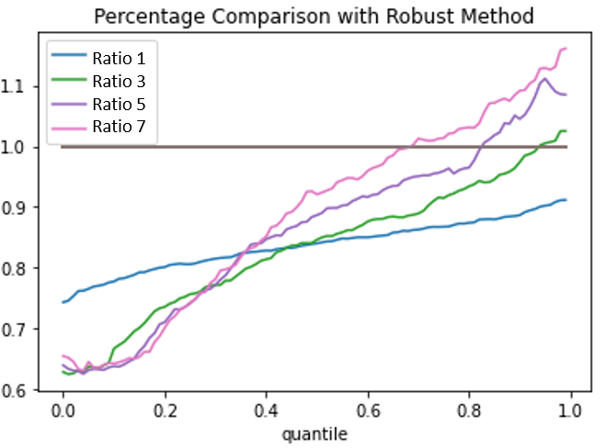




Ratio of cost of end-to-end model to robust model
$$ρ=1$$
$$ρ=3$$
$$ρ=5$$
$$ρ=7$$
Quantile

Slide 2
